Slide 1
CARIAD Deal Overview
CARIAD = CAR, I Am Digital
12 Sep 2022

Slide 2
Client Background and Business Objectives
Client Background
Client Overview | Automotive Software for Volkswagen Group for all VW brands
Where They Are | Headquartered in Wolfsburg 4500 employees offices in Germany, China, Israel, North America, India
DXC Presence | DXC / Luxoft is currently del. Several application related services
New Opportunity for DXC | New opp. for DXC
Customer Business Objectives | Freeing up resources to focus on new technology and enhancements Higher degree of factorization and automization Part of S/W based in car technology to be expected to raise from ~10% today up to ~60% in the mid future
Opportunity Scope
Development, Testing and Operational Services of 2 Lots: - Lot 1: 36 Core Apps: connection between the vehicle and the MBB (Modular Backend Building Block) - Lot 2- 30 CAR2X Apps: Vehicle-related services + Green services of 8 Apps: Intelligent Charging Backend (ILF) and Plug&Charge Backend (PnC)) and Content Management System (CMS) + Enabler services (CI/CD pipeline and testing frame- work) Level 2 and Level 3 Support with DXC Establish DevOps way of working
Client Objectives met
DXC is able to provide real End-2-End Service Comprehensive DevSecOps Services with primary focus to stabilize outcomes Quality Assurance is key: CI/CD and Test Automation High scalability for continuous growth Very high quality of service and meeting SLAs Cost efficiency and cost transparency Compliance with the data protection and security requirements Holistic documentation Accelerate time-to-market for changes
Client Challenges to Overcome
Digitalization and electromobility are the top innovation drivers in the automotive industry today. Carriad has to overcome: Unstable Services caused by siloes delivery Process frictions Free-up resources for future platform development
Solution Team and Roles
Colin Schmidt: T&T Carsten Arenz: MSLA Christoph Pap: SLA Applications Services Neela Lahit Praharaj: Application Services/DevOps Rakesh Vaila: Application Team-PACE Uwe Vollbrecht: TL Custom Apps Org (Delivery) Stoil Temelkov: Security Laura Zijno: ITSM Plieth, Stefan: Testing Andreas Jordan: Managing Consultant Somasundaram, Maruthachalam: Agile Coach Matt Kay: Global Product Manager Applications Mildebrand, Markus (DXC Luxoft) Kraehe, Ronny (DXC Luxoft):

Slide 3
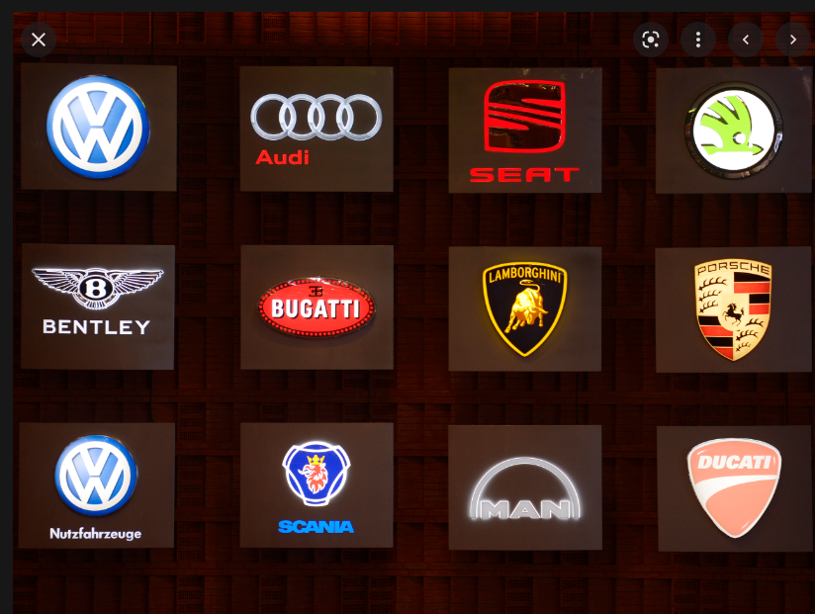
Volkswagen Group
CARIAD = CAR, I Am Digital
(IT service unit of VW Group)
12 Brands
Colin
Christoph
Hi Team,
Have fun,
Choose your
brand ☺
Simansu
Smilan
Neela
Jaga
Biju

Slide 4



















DXC/Luxoft –What we do at VW now ? We are the Strategic IT and Engineering Partner for Cariad
Connected Cars/ Services
R&D & InCar IT
Infrastructure Setup and Operations
Share42morrow
(R&D DMS)
MBB Operation
ADSPC
(CC AMS)
Car Net
Business Cloud
Aftersales and Services
Global MDM Ingest
(Data Driven Dev.)
Application Plan & Build
VW OS: CI/CD
RTM
Big Data
Diagnosis
Architecture
China: Robo Taxi ML/Data Mgt Support
E3: Diagnosis, OTA, DSA
MBB Lift&Shift to Azure
Premium Car
Configurator
Spare Parts Pricing
Vehicle Cyber Security
(Pen-Testing, darknet
analysis)
AD: Highway Pilot
MIB & ICAS Dev,
Group
Vehicle File
DDW Dev.
Digital Driver Workspace
Remote
Repair
FIS Rollout
Support
Remote Production
Cloud Architecture
My Porsche
Porsche DC Suport China
Operated Factory Support China
SAP S/4 HANA China
Mein Auto
SAP R/3 Unit
DPP: OT/IT Gateway
DWH Design& Implementation
myAudi
Production & SCM
Factory IT Support Audi HU
GITC Governance &
Automation
Premium CC
Sales & Marketing
S4BUS Roll out
Analytics
Operation
SPR Platform
Analytics
Operation
Operated Factory Bratislava
Identity & Access Mgnt.
i-Serv
(Service Now)
Web
Center
DC Move
Application Management
Cloud Migration
Factory
In China
Strong Partnerships
Luxoft References @ VWG
Corporate Functions
DXC References @ VWG

Slide 5
Our Goal:
We – the DXC Team - will Help Volkswagen Group to fight against
the competition (Tesla) with best in Class Services for Millions of cars on the streets
arround the globe.

Slide 6
Cariad (from Wikipedia)
Cariad SE (Eigenschreibweise CARIAD) ist eine Automotive-Software-Tochter im Volkswagen-Konzern. Der Konzern bündelt in ihr seine Software-Entwicklung, einschließlich der Arbeit an einer einheitlichen Software-Plattform für alle Pkw-Marken des Volkswagen-Konzerns, dem VW.OS und der Volkswagen Automotive Cloud (VW.AC).
Mit der neuen Organisation soll der Software-Eigenanteil im Fahrzeug von derzeit zehn auf mindestens 60 Prozent gesteigert werden.^{[2][3]} Etwa 50 Prozent der Mitarbeiter werden in Europa tätig sein, der Großteil davon in Deutschland; ein Drittel in China, und weitere Mitarbeiter in Nordamerika, Israel und Indien.^{[4]} Konkret selbst entwickeln will VW Fahrerassistenzsysteme, digitale Sprachassistenten, Cloud Navigation und Mehrwertdienste für Parken oder Flottenmanagement. Es gibt mehrere Standorte in Deutschland: Berlin, Bochum, Ingolstadt, Mönsheim/Stuttgart und Wolfsburg.
Cariad SE (CARIAD) is an automotive software subsidiary in the Volkswagen Group. The Group bundles its software development in it, including work on a uniform software platform for all passenger car brands of the Volkswagen Group, the VW. OS and the Volkswagen Automotive Cloud (VW. AC). With the new organization, the software contribution in the vehicle is to be increased from the current ten to at least 60 percent. ^{[2][3]} About 50 percent of the employees will be based in Europe, the majority of them in Germany; a third in China, and additional employees in North America, Israel and India. ^{[4]} Specifically, VW wants to develop driver assistance systems, digital voice assistants, cloud navigation and value-added services for parking or fleet management. There are several locations in Germany: Berlin, Bochum, Ingolstadt, Mönsheim/Stuttgart and Wolfsburg.
Als Car.Software-Organisation von VW im Juni 2019 eingerichtet, operiert das Unternehmen seit dem 1. Januar 2020 als eigenständige Geschäftseinheit. Der Eintrag laut Handelsregister vom 27. Dezember 2019 lautet SW Org Wolfsburg AG. Ende 2020 erfolgten einige Verschmelzungen: TKI Automotive GmbH, Carmeq GmbH, diconium GmbH, Audi Electronics Venture GmbH.
Am 26. März 2021 wurde der Name in CARIAD – zusammengesetzt aus "CAR, I Am Digital" – geändert. Neben dem Markennamen CARIAD wechselte auch die Unternehmensform zur SE, was unter anderem eine angepasste Mitbestimmung auf Aufsichtsrats- und Betriebsratsebene ermöglichen soll.
Established as VW's Car.Software organization in June 2019, the company has been operating as an independent business unit since January 1, 2020. According to the commercial register of 27 December 2019, the entry is SW Org Wolfsburg AG. At the end of 2020, several mergers took place: TKI Automotive GmbH, Carmeq GmbH, diconium GmbH, Audi Electronics Venture GmbH.
On March 26, 2021, the name was changed to CARIAD – composed of "CAR, I Am Digital". In addition to the brand name CARIAD, the company form also changed to the SE, which, among other things, should enable adapted co-determination at Supervisory Board and Works Council level.

Slide 7
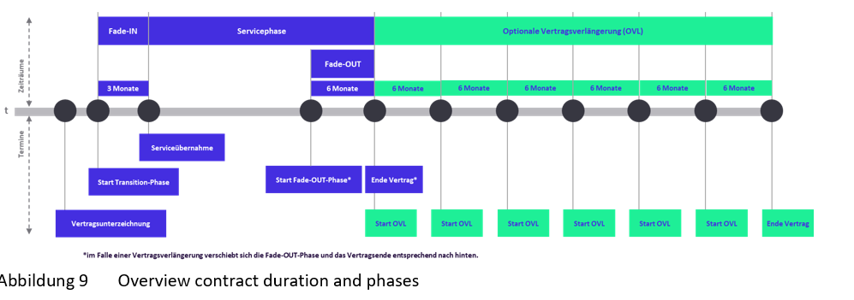
Timeline
Start date – Oct 1st 2022, 5 Years + 36 Months Extension- potential

Slide 8
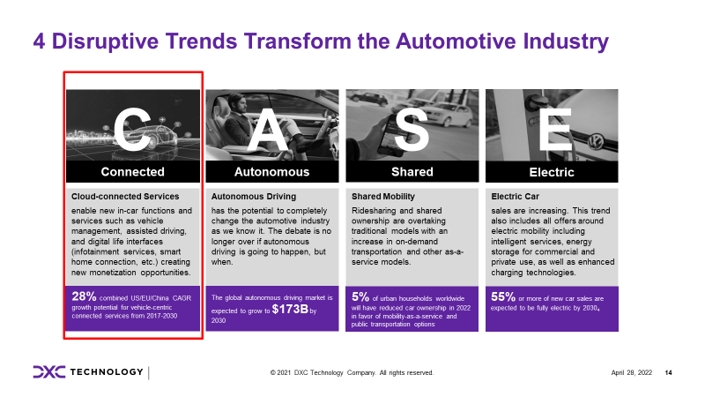
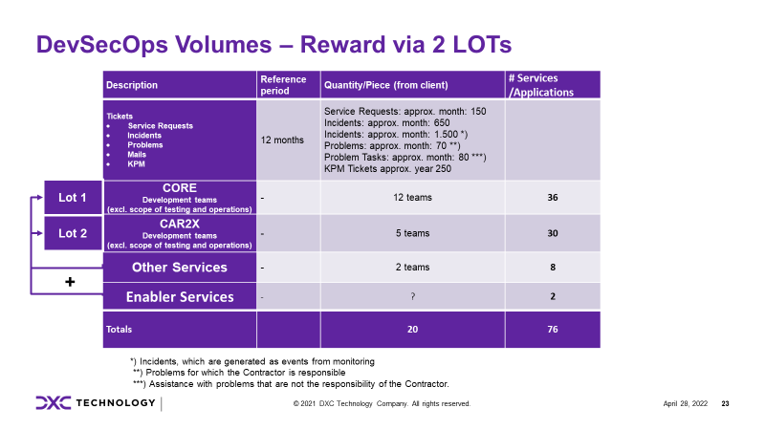
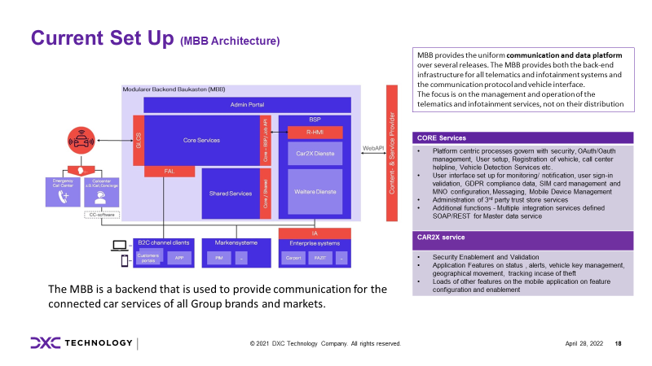
Opportunity Scope
RfP for 2 Lots
CORE + enabler/Other Services (12+2+1 Teams/36+8+2 Apps)
Car2X + enabler/Other Services (5+2+1 Teams/30+8+2 Apps)
5 Y plus 6*6 month Prolongation
We offer LOT 1 & LOT 2
Next pages shows Lot 1 and Lot 2 together

Slide 9
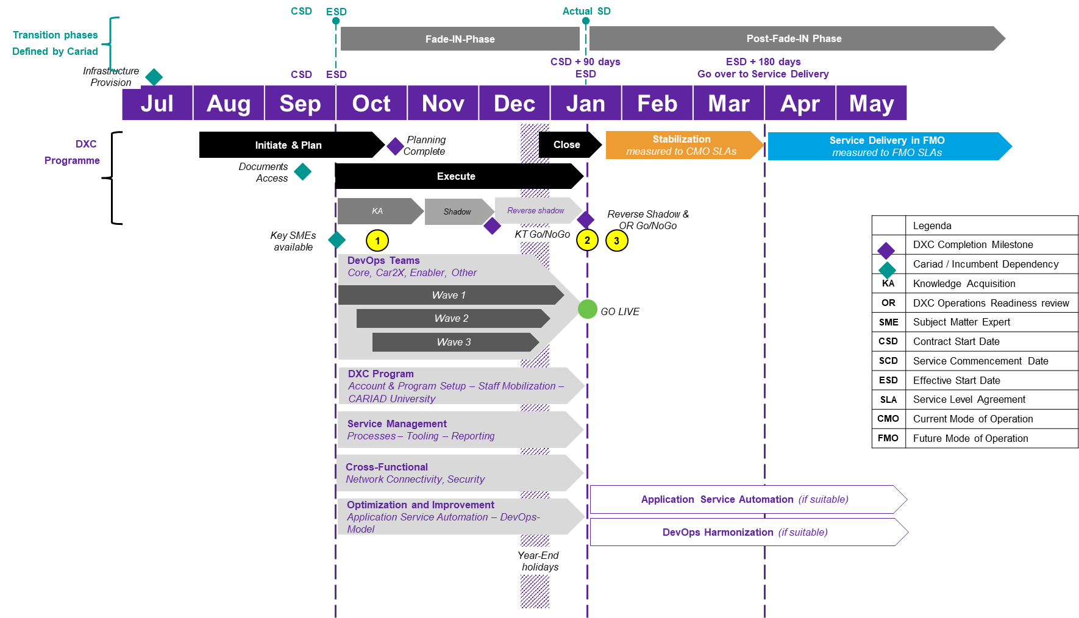
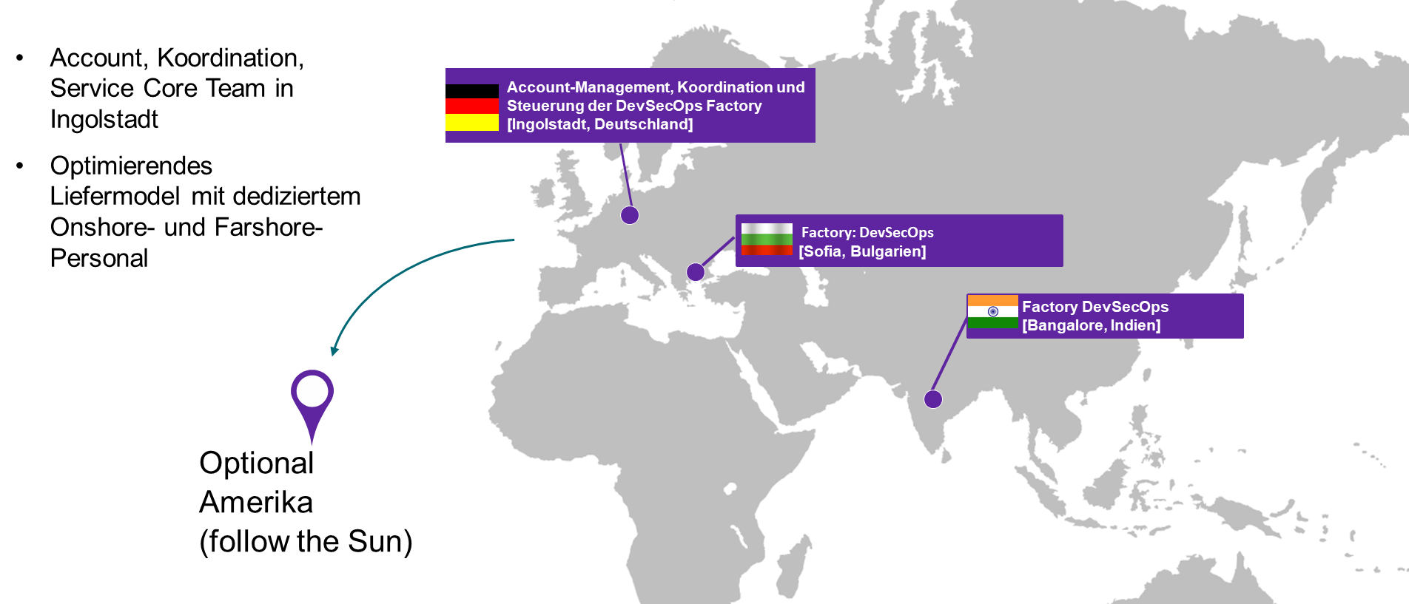
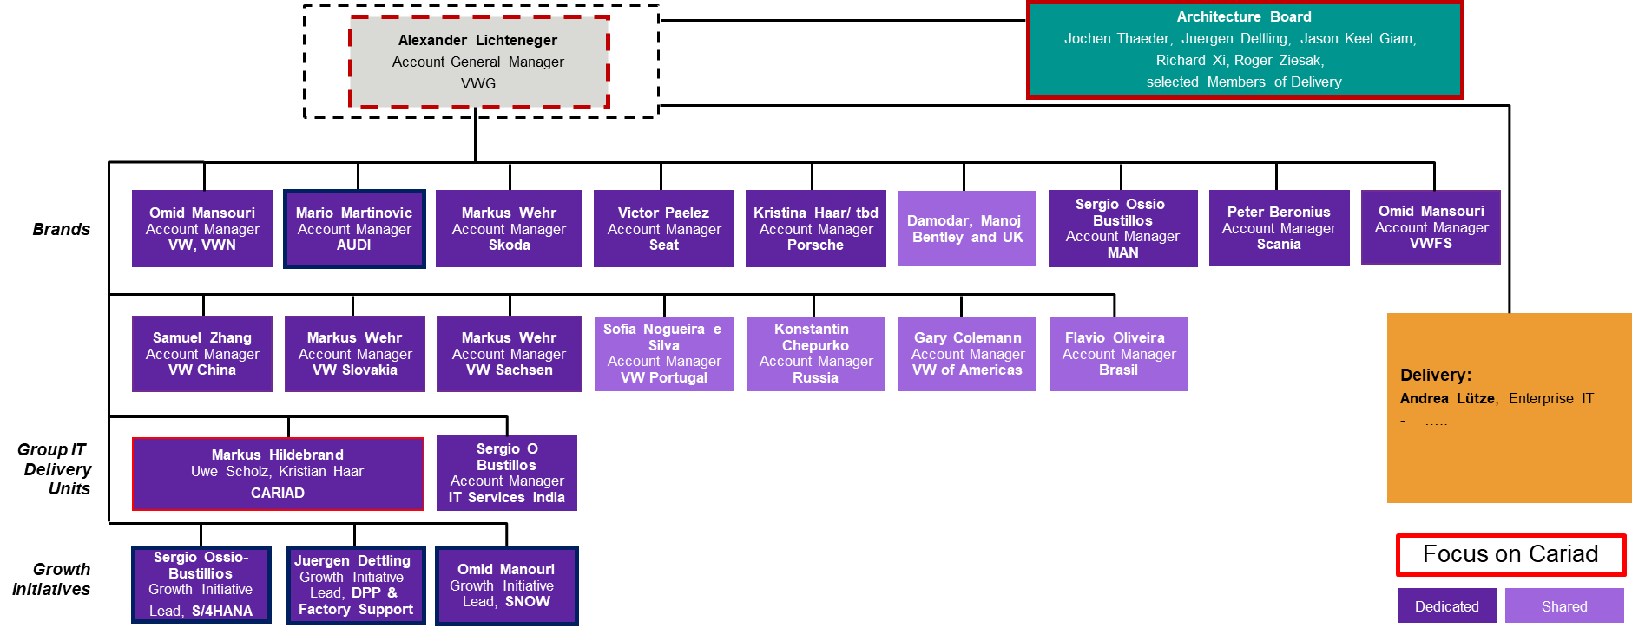
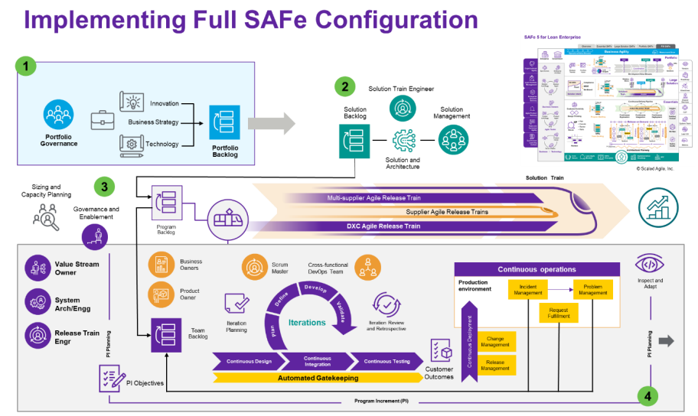
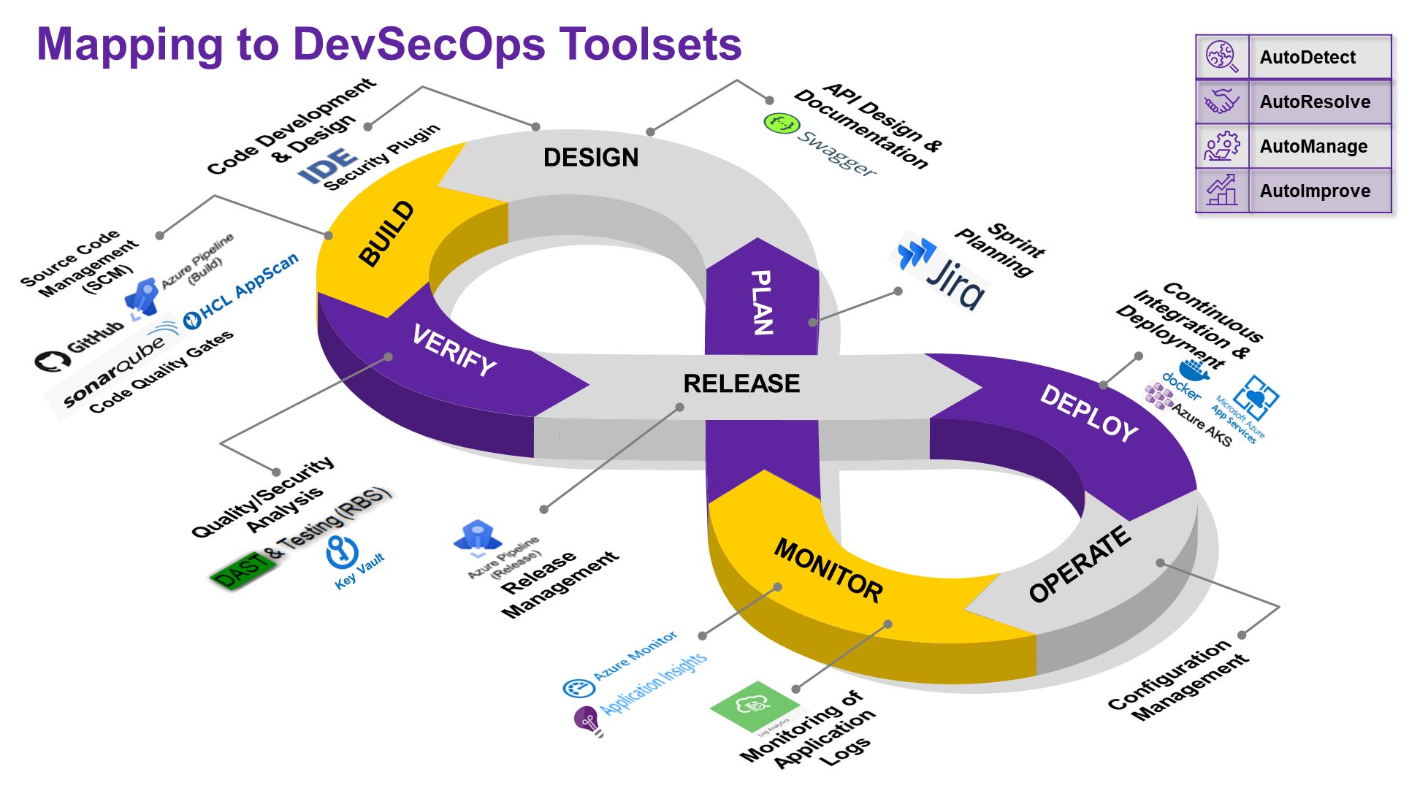
DXC Solution for Cariad
No Surprises
Risk free Transition
Assess Cariad environment
Take over Responsibility (as is)
Stabilize Delivery
Fast Transform to agile DevSecOps Organisation
Based on proven methods, tools, concepts to increase quality, increase time to market, reduce costs
Global scalable Delivery Model
Cariad Onsite focus (German)
Dedicated Nearshore Cariad Team
Dedicated Farshore Cariad Team
Extension to the existing Account Governance Structures
We know were we are:
people
structures,
processes,
tools, ...
Delivery Transformation to full SAFe
technical transformation
organisational adaption/transformation
Cultural adaption/transformation
Use of Full DecSevOps Toolset and more…
Use of best practises
CI/CD chain
Embed Security in DecSecOps
Automation (RPA/AI/Robotics), Lean Management
Application Modernization
We deliver an end to Solution: We build it, we ship it, we run it

Slide 10
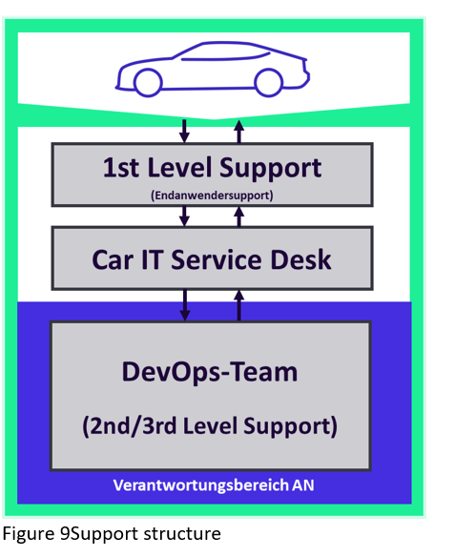
Service and Support Structure asked by Cariad
Customer Responsibility
1st Level Support
Car IT Service Desk
Service Provider
DevOps team
Roles sought*
Account Manager
Service Manager
Quality Manager
Process Manager
Project manager- Integrated Projects
Critical Incident Manager
Site Reliability Engineer
DevOps team *
Proxy Product Team
And a wide list of activities
*Roles-> see Lastenheft
chapter 2.4.6 ff with further details
SAFe Experience
In-depth experience in the application and implementation of agile project methods based on Scrum and SAFe
Language requirements according to CEFR: German and English (at least one profile C1 the second profile B2)
Resilience in stressful situations, dealing with unpredictable situations
Understanding of customer needs and problems
High level of feedback, criticism and conflict management skills
High ability to work in a team and social competence
Time and self-management, high level of initiative
High understanding of quality and professionalism
Understanding of processes and procedures in the automotive industry
Experience in the application and implementation of agile project methods based on Scrum and SAFe
Scripting and programming skills
Know-how in virtualization solutions
Deep expertise in development, operations and agile, databases and automation
Very experienced regarding software development
Very experienced regarding test procedures, test strategies and test systems (tools)

Slide 11
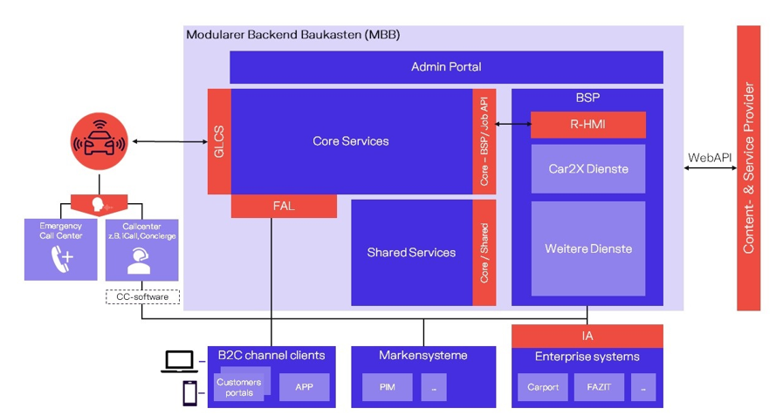
Current Set Up (MBB Architecture)
MBB provides the uniform communication and data platform over several releases. The MBB provides both the back-end infrastructure for all telematics and infotainment systems and the communication protocol and vehicle interface.
The focus is on the management and operation of the telematics and infotainment services, not on their distribution
The MBB is a backend that is used to provide communication for the connected car services of all Group brands and markets.

Slide 12
DevSecOps Volumes – Reward via 2 LOTs
Description | Reference period | Quantity/Piece (from client) | # Services /Applications
Tickets Service Requests Incidents Problems Mails KPM | 12 months | Service Requests: approx. month: 150 Incidents: approx. month: 650 Incidents: approx. month: 1.500 *) Problems: approx. month: 70 **) Problem Tasks: approx. month: 80 ***) KPM Tickets approx. year 250
CORE Development teams (excl. scope of testing and operations) | - | 12 teams | 36
CAR2X Development teams (excl. scope of testing and operations) | - | 5 teams | 30
Other Services | - | 2 teams | 8
Enabler Services | - | ? | 2
Totals |  | 20 | 76
Lot 1
Lot 2
+
*) Incidents, which are generated as events from monitoring
**) Problems for which the Contractor is responsible
***) Assistance with problems that are not the responsibility of the Contractor.

Slide 13
Used Technologies at Cariad- ask is to reuse unless a strong reason to propose something else
Die nachfolgende Auflistung gibt einen groben Überblick über die derzeit eingesetzten Technologien und hat keinen Anspruch auf Vollständigkeit:
Access Management - Tivoli Access Management Webseal
AWS Services (RDS, EC2, Cloudwatch u. a.)
Java-Backend
CA APM
Cassandra
Concourse
Content Management - Adobe Communique (Day)
Directory Proxy Server SUN
DNS - BIND
Dynatrace
F5 Firewall
Gradle
Grafana
Jenkins
Kafka
Kibana
Kubernetes / Docker
Linux (Redhat u. a.)
Maven
Microsoft Domain Controller
Microsoft Federated Identity Mgmt.
Microsoft Key Management Server
Microsoft SQL Server
MongoDB
MQTT (Message Broker)
NDM WebSphere
NFS
Open API
Oracle
Portal Liferay
Portale - WebSphere Portal Server
Redis
Rsync
RVS
Splunk
Tivoli Access Manager Policy Server
Tomcat Application Server
Translation - WebSphere Translation Server
WAF
Web Scraping Software - Kapow
Web Server – Apache
Web Server - IBM HTTPD
Web Server - Microsoft IIS
WebSphere Application Server
WebSphere Message Broker

Slide 14
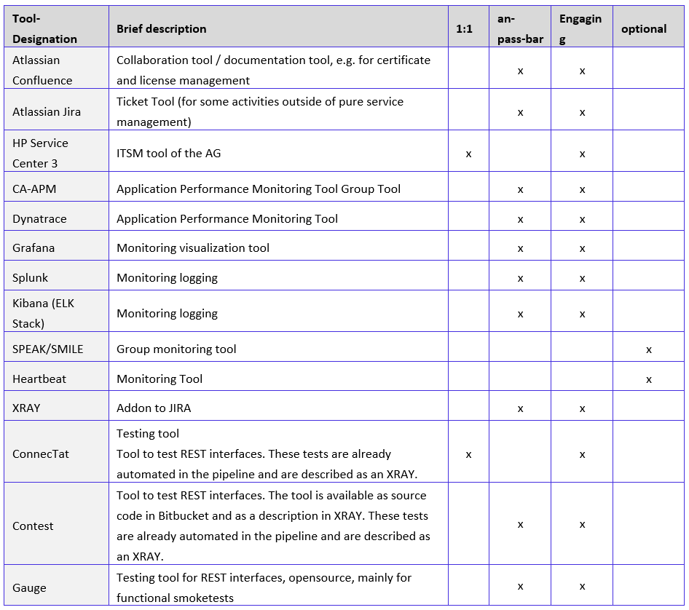
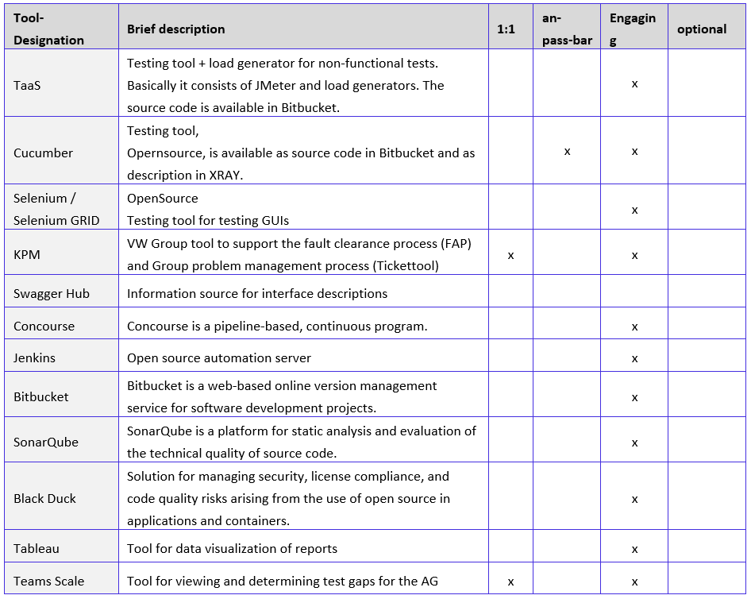
Current Tools Landscape
Potentially
to be changed
Mandatory

Slide 15
Requirement
High scalability for continuous growth
Very high quality of service for customer and meeting SLAs for more demanding functions
faster time to market, by reducing roll-out and update cycles
High cost efficiency and cost transparency in the project
Compliance with the data protection and security requirements of the AG
Holistic documentation
Application of standard software products , in case of need AG-specific extensions (individual development)
Regular commercial and technical control of the progress of the contract by the contractor and the AG.
Clear principles according to which the project will be carried out and a clear project vision as a representation of the project goal.
Collaboration between project teams based on partnership:
Timely and practical specification of requirements by means of user stories (epics), whereby the customer actively participates in their definition and is responsible for them.
Immediate communication in case of problems, even if it jeopardizes cooperation.
Maximum flexibility in the realization of projects:

Slide 16
Solution Overview

Slide 17



Solution Scope
Applications
Applications:
Portfolio of 76 Applications as part of MBB and ODP Platform
Innovation and Governance
Governance Organization
Key Scope of Services
Multiple languages
(German, English)
Java application with multiple DB and CICD tooling (Open Source), Dynatrace
Connected car- experience
Application Support
Monitoring/Incident/ Problem/Change
Deployment/version updates
Service Requests
Software Development
Projects- CORE and CAR2X
Design/build/Test/ Rollout
Roadmap
Enablement- CICD tooling
Technologies
Design Thinking, SAFe DevOps Transformation,
Establish One-Team approach
Service Coverage
24*7*365
DXC Advisory
Industrialized Delivery
Automation
Continuous Improvement
Knowledge Mgt.
Security
Agile KPI
Performance Measures

Slide 18
High level scope
Background: Digitalization and electromobility are the top innovation drivers in the automotive industry today. CARIAD is an automotive software subsidiary in the Volkswagen Group. The Group thus bundles its software development in CARIAD, including work on a uniform software platform for all Volkswagen Group brands. Part of the software consists of the development and operation of the Modular Backend Building Block (MBB), which is realized in the two solution spaces as described in chapter Technical Specification. As part of its service provision, the Contractor shall undertake the new and further development of functions (including "microservices" and "software increments"). The delivery of the development service to the customer is largely carried out via a Continuous Integration Platform (CIP).
The Contractor must follow the SAFe framework for agile software development used by the Client and maintain a backlog that is transparent for the Client.
Scope :Development, testing and operational services
Application Maintenance
Software maintenance
Bug fixing
Application Development
Contractor is responsible for the complete software life cycle from its development to its implementation and operation as described in the following chapters.
The realization is to be carried out according to the SCRUM methodology and the Scale agile Framework (SAFe).
User Stories driven

Slide 19
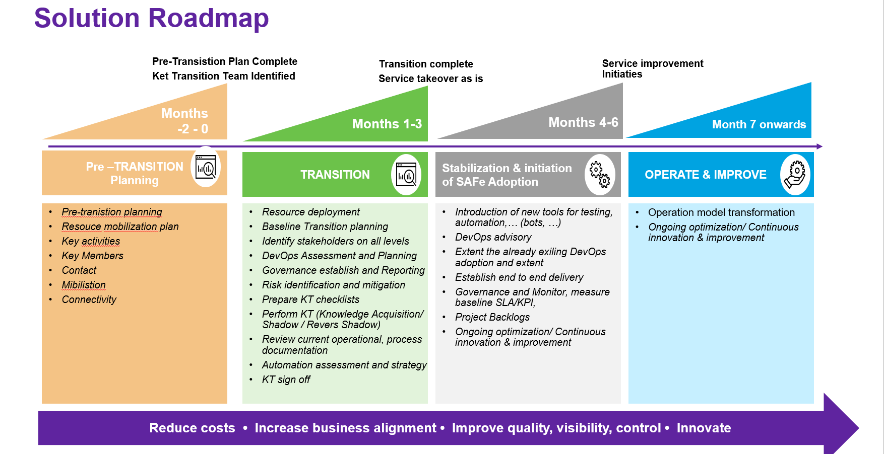
KT Period- Month 1- Month 6
Months 1-3

Slide 20
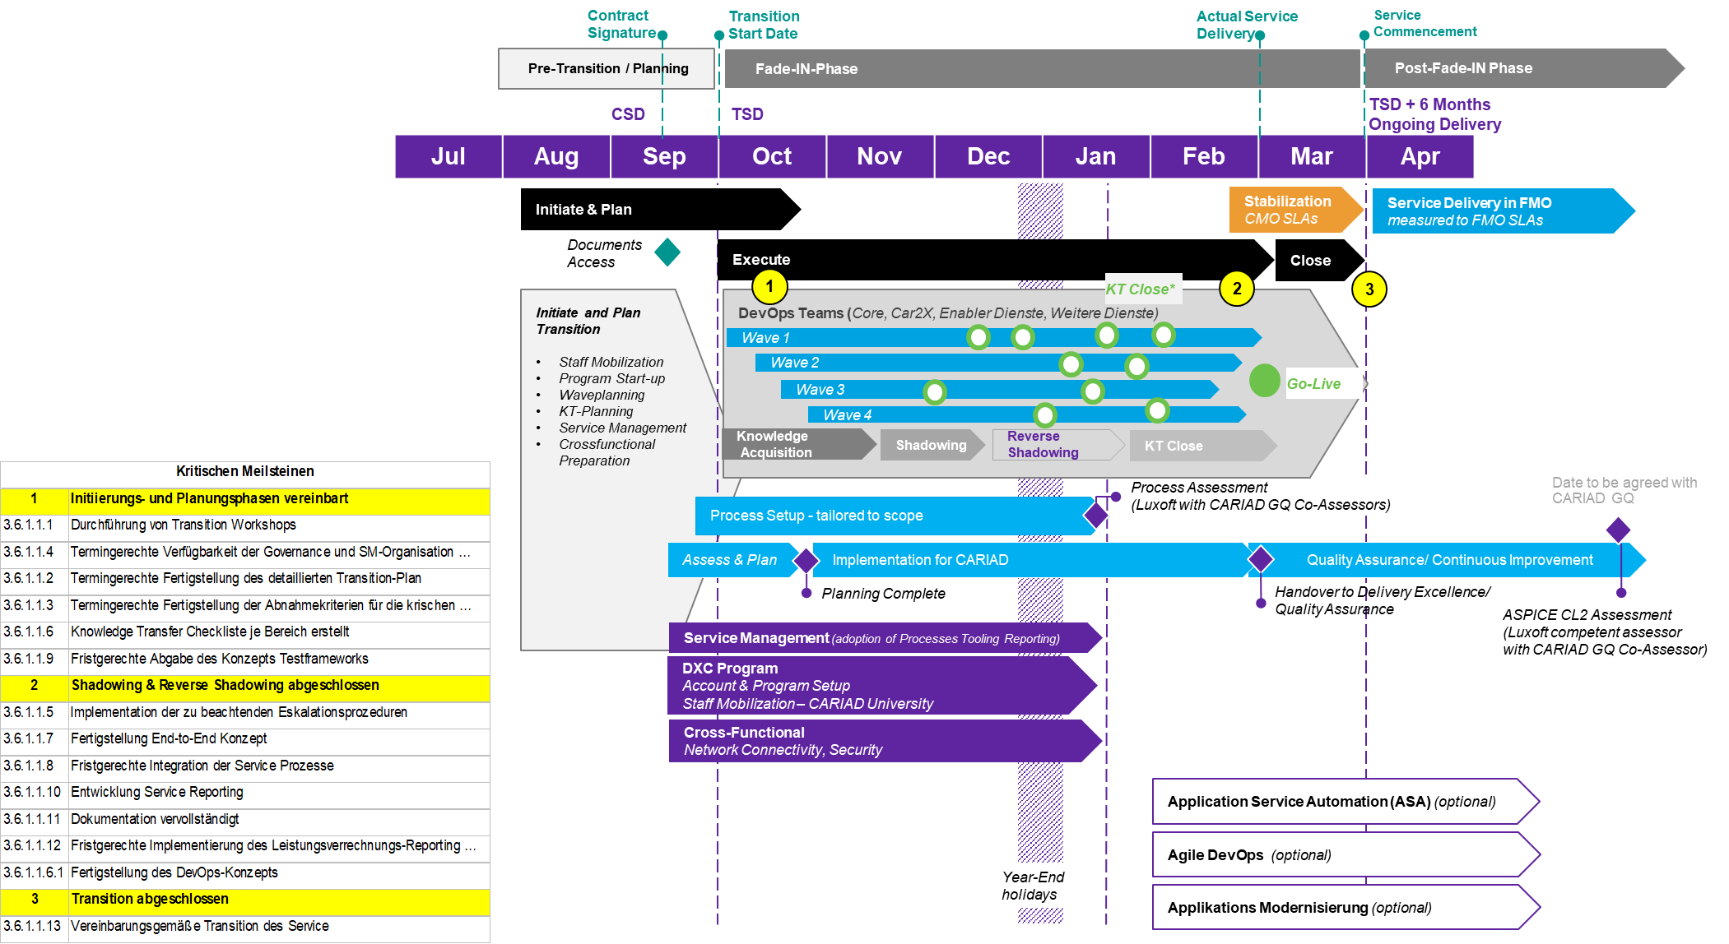
T&T Timeline

Slide 21
Account General Manager
(Account Manager)
Account Delivery Lead
(Service Manager)
Transition Program Lead
(Transition Manager)
Transition Lead
Transition Lead
Transition Leads
T&T PMO Lead
Technical Transition Lead
Service Readiness Lead
Human Resource Lead
DXC Programm
DevOps-Teams
Service- Management
X-functional Services
Optional
Transformation Projects

Slide 22
Transition Program
DXC Program
DevOpsTeams
Service Management
Funktions-übergreifende
Services
Optional
TransformationProjects
Account &
Program-Setup
Core Apps
Processes
Network -Connectivity
Application Service Automation
Staff Mobilization
Car2X /eV
Tools
Identity- and Access Management
DevOps Harmonization
CARIAD University
Enabler-Services
Reporting
Application Modernization
Other Services
DevOps Enablement Team includes a) Agile Coach, Architect, Developer, Tester, Automation Engineer, SRE, DevOps Engineer

Slide 23


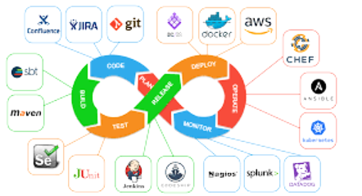







Service Delivery Alignment to Cariad Objectives
Business Services
solution components
Technology-independent high availability & scalability
Guilds and Best Practices
Cloud partnerships (AWS, AZURE, Google, etc.)
Industry experts and knowledge management
Highly automated tools, highly automated testing
Process management to ensure the highest service operations standards and procedures
Core
Car 2X
Enabler Dienste
Weitere Dienste
Connected Car Service
Service Components
Operations Support(L2/L3)
LifeCycle Management
Release Management
Applikations-entwicklung
Hypercare
Site Reliability Management (NFR)
Integration Service
Key Technology Landscape
DXC
Teams
ITIL Governance
Sprint Teams
Architecture
Automation
Security
Fade-In Phase*
Account CTO
Service Manager
Incident and Problem Manager
Release Manager
Process Manager
Quality Manager
Availability & Capacity
Configuration
Proxy Product Owners
Scrum Masters
Developers
Testers
Enterprise Architect
Cloud Architect
DevOps Architect
Java Architect
Database Architect
DevOps Engineer
Test Automation
Security Lead
Security SMEs
Transition Management lead
Transition Managers (Germany, India and Bulgaria)
Transition PMO
Knowledge Management
Continuous Service Improvement

Slide 24
DXC CARIAD Account
Governance
1
Account General Manager
(Account Manager)
Account Strategische und Funktionale Meetings/Boards
4
1
Steuerkreis
CTO
Innovation
Account Delivery Leader
(Service Manager)
1
2
3
Project
Managers
Account
PMO
Transition
Manager
Account
Architect /
3
2
Quality
Manager
Security
Manager
Contract
Manager
Finance
Manager
Account Business
Manager
Service Review
Meeting
2
DXC Service & Release
Management
ITIL Service Mgr.
(Process Mgr)
Account Run Leads
Standard Service
Requests
Reporting Team
Critical Inc. Mgr
Non-Standard
Service Requests
Process Support Mgr:
Incident, Mgr
Problem Mgr
Change & Release
Serv Lev Mgr
Availability Mgr
Capacity Mgr
Configuration Mgr
Document Mgr.
Quality Board
3
SRE
Innovation
DevOps:
L1 Core
DevOps:
L2 CAR2X
DevOps:
L2 eV
Enablement
Sys Teams
4
Scrum Master / SRE
Product / Proxy Product Owner
Scrum Master / SRE
Product / Proxy Product Owner
Scrum Master / SRE
Product / Proxy Product Owner
Scrum Master / SRE
Product / Proxy Product Owner
CARIAD requested DXC Roles

Slide 25
Operating Model-Future
Business Applications
Core
Weitere Dienste
Enabler Dienste
Car 2X
Service
Components
L1-Service Desk (Out of scope)
Lead / Customer facing Roles
Cross Functional
AGM
Account Architect
Account Run Lead
L2- Incident Management
Germany (German Business Hours)
ADE
Service Manager
Security Ops Manager
Bulgaria 24x7 Support
Roles
Proxy Product Owner,
DevOps Coach, Agile Coach, RTE
Sr Developer and Tester
Security Ops Lead
Security SpoC –Dev-2
Account Run Lead
Roles
Support Engineers , Tester
Account Reporting Eng.
Privacy leads-2
Account Architect
Site Engineer
Quality Champion
CTO
ABM / PRM
Service Manager
L3- Problem Management
Projects-Development
Incident Managers-7.5
PMO
App Security Advisor
Transition Team
Roles
Architects
Developers ( Java, DB, CICD )
Testers
Scrum Master
App Security
T1- Transition Manager
T1-Transition Manager
Offshore Delivery Lead
Agile Coach
RTE
T&T –Program –T2
T1 Scheduler
T&T –Program –T1
Architects
India (German Working Hours)
DevOps
Database
Java
Cloud
SRE
Germany
Bulgaria
Germany and Bulgaria
India

Slide 26


DXC End2End Service Overview “You build it, you run it”
DXC VW Group
Lösungskomponenten
Jeder CARIAD-Product Owner bekommt einen DXC Proxy-Product Owner zur Seite gestellt
Hybrides Liefermodell unter Berücksichtigung der Rollenanforderungen gemäß CARIADs Lastenheft
Verwendung von CARIAD-Tools mit der Option der Erweiterung durch DXC Tool-Stacks
An SAFe angelehntes Service- Modell mit Schnittstellen zu CARIAD-Einheiten
ASPICE & TISAX als Fundament
CAR IT Service Desk & Level
DXC CARIAD Account
Governance
Portfolio Level
ITIL Processes
Process Management
DXC Service & Release
Management
ITSM
…
Solution & Service Level
Unplanned
Incident Resolution
Emergency Patching
DevOps:
L1 Core
DevOps:
L2 CAR2X
Weitere Services Sys Teams
Enabler Dienste
Team
Client Response
DevOps
DevOps
DevOps
DevOps
9 DXC Sprint Teams
5 DXC Sprint Teams
2 DXC Sprint Teams
1 DXC Sprint Team
Team Level
Planned
Incident Reduction
Problem Management
Patching / Upgrades
Project Development (Scrums)
Availability Engineering
Proxy Product Owner
Proxy Product Owner
Scrum Master
Developer
Tester
DevOps Engineer’s
Proxy Product Owner
Proxy Product Owner
Scrum Master
Developer
Tester
DevOps Engineer’s
Proxy Product Owner
Proxy Product Owner
Scrum Master
Tester
DevOps Architect
DevOps Engineer’s
Proxy Product Owner
Proxy Product Owner
Scrum Master
Developer
Tester
DevOps Engineer’s
Change & Transform

Slide 27


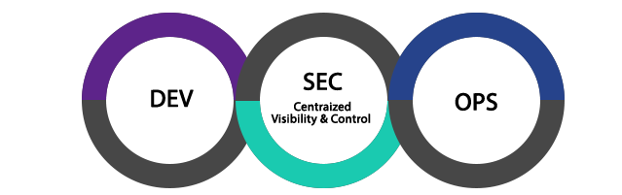




Combined Dev and SecOps in an Agile Delivery Model How we deliver & align our delivery workflow with an incremental Agile release approach
Daily Scrum
Dev Workflow
Sprint Backlog
Scrum Master
Pod
Sprint Retrospective
Combined Dev/Ops team responsible for in scope apps (incl. Future app/ enhancements)
2-4 week Sprint
Close collaboration with Customer product owner
Scrum of scrums
Backlog Refinement
Includes testing & development capability
Product Owner
Product Backlog
Potentially shippable product increment
Sprint Planning
Where there are multiple Pods they collaborate across Scrum of Scrums
Prioritisation
Add to sprint backlog
High Priority Incident Fixes
Service Requests
Ops Workflow
Service Desk
Incidents
Combined Dev/Ops team responsible for in scope apps
Service Requests
Automated & Manual Fulfilment
High priority operations activities may be delivered outside sprint cycle
Maintenance Backlog
Incremental Automation
Automation delivered where possible inside the sprint cycle on a regular cadence
Pod
Toil evaluation

Slide 28
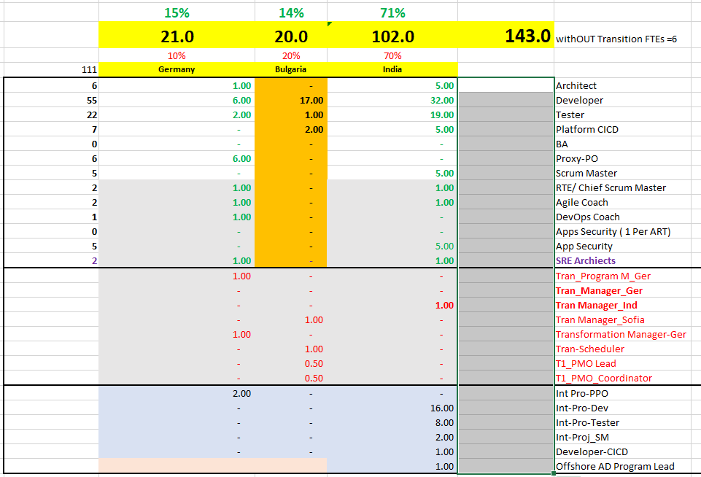
Team Composition
DevOps Team
App Maintenance : 32
Application Development
RUS (Reference User stories) : 81
Integration Projects : 30
Service Management : 17
Transition Team
Program Manager (Ger)
Transition Manager (Ind)
Transition Manager (Bulgaria)
PMO Lead (Bulgaria)
PMO Coordinator (Bulgaria)
Scheduler (Bulgaria)

Slide 29
Service Catalog Offering Application Solution
Current Environment |  | Target Environment
36+30 applications for www.cariad.de (CAR2x and CORE) Delivered by two incumbents (ATOS, MSG and Valtech) delivered by 12+5+2 Agile teams Cariad way of working (…), Cariad Toolsets and Infra |  | Deliver Support and Build responsibility using DevOps framework Use Cariad Toolsets and infrastructure German Language for key customer engagement roles ( Proxy Product Owners) Mixed delivery from Germany, Bulgaria and India Improved efficiency and increased velocity
Transition / Transformation Project / Approach & Timeline |  | Describe how we will achieve Y1 operating costs, and future efficiencies | Describe how we will achieve Y1 operating costs, and future efficiencies
Balanced Transition approach with manageable risk and cost DXC standardized KT approach possible (6 month) Take holiday season into account Resource ramp up 2-6 months |  | Efficiencies by optimizing the operating model over period of engagement ( refined estimation model, optimize pyramid) App Service Automation Work placement improvement within 3 locations (Onshore – Germany 14%, Nearshore-Bulgaria 19% and Offshore India 67% ) Continuous improvement part of Agile way of working
Solution Assumptions | Solution Tasks |  | YoY Volumes
German speaking resources with requested technical skills available in Germany/Eastern Europe per transition timeline | Decide which roles delivered from onshore/nearshore 6 month Transition timeline Mapping of DXC/Luxoft roles to Cariad roles Ramp up readiness Completed RAC (Risks/Assumptions) |  | YoY – Provided by customer Optimization Proposed 9%,8%,6%,1% (cost)
Client Dependencies / Responsibilities / Restrictions |  |  | SLAs
Adhere to RFP timelines Make incumbent resources available during T&T and some key players beyond (6 month) |  |  | Support : 24*7 8% CAP (see details in SLA slide) Partially Platin Status
YoY Cost Walk | T&T | Y1 | Y2 | Y3 | Y4 | Y5 | Y6 | Y7 | Y8 | Total
Apps Dev | $ 1,3 M | $ 3,65 M | $ 3,33 M | $ 2,97 M | $ 2,72 M | $ 2,59 M | $ 2,52 M | $ 2,5 M | $ 2,48 M | $ 24,06 M
Apps Mgmt | $ 1,19 M | $ 1,77 M | $ 1,30 M | $ 1,22 M | $ 1,16 M | $ 1,12 M | $ 1,10 M | $ 1,09 M | $ 1,08 M | $ 11,03 M
Int. Projects | $ 0,25 M | $ 0,93 M | $ 0,93 M | $ 0,91 M | $ 0,88 M | $ 0,85 M | $ 0,84 M | $ 0,83 M | $ 0,82 M | $ 6,98 M
Notes:
Guidance
There should be a separate slide for each service / offering area in scope including, but not limited to –
Application Services
Consulting
Industry SW & Solutions
Big Data & Analytics
Cybersecurity
Service Mgt
Platform
Workplace
Data Center & Networks
Project Services
Cloud
SSI / T&T
Etc.

Slide 30
CARIAD‘s Application Complexity Ratings

Slide 31
DXC Service Management Overview
Current Environment in AUDI |  | Target Environment
Account Cariad Team managed Service /integrated with Audi Team ITSM tool of customer and process of customer HPService Center 3 Reporting done via BO-Reporting Team scripts Service Management Cariad team integrated in audi team |  | Expand existing SM teams with exactly same FTE for CARIAD (except for CIM) Allin DXC into Customer Tool and process – expand existing Audi SM Team CIM -expand existing Audi SM Team from 9 fte to 14 FTE SSR in Customer tool – NSSR – aldea update aldea but process – as done via Account DOCM – resue customer DOCM out of scope PPM – in scope – out of sope Language English/German – to define more in DD German translation with deepl.com licences
Transition / Transformation Project / Approach & Timeline |  | Describe how we will achieve Y1 operating costs, and future efficiencies | Describe how we will achieve Y1 operating costs, and future efficiencies
Align with customer tool and process |  | Synergy with current Audi IT resources
Solution Assumptions | Solution Tasks |  | YoY Volumes
Possible reuse of Audi IT resources and expand the team Account dedicated Expand CiM with further 4 FTE T&T process 5 FTE for 3 months reusing audi process and updating available document to adapt to CARID Tranlation tickets using deepl.com licences (20) | Align to customer process and Tools Update process for CARIAD Included also an Account Site Engineer devops/ARL from India to coordinate Dev-ops |  | Incident: 2100 Problem: 70 Changes: SSR: 700 NSSR: volume to be confirmed
Client Dependencies / Responsibilities / Restrictions |  |  | SLAs
Process on customer side |  |  | Generic – to be further discussed and aligned
Notes:
Guidance
There should be a separate slide for each service / offering area in scope including, but not limited to –
Application Services
Consulting
Industry SW & Solutions
Big Data & Analytics
Cybersecurity
Service Mgt
Platform
Workplace
Data Center & Networks
Project Services
Cloud
SSI / T&T
Etc.

Slide 32
Service Catalog Offering Security
Current Environment |  | Target Environment
36+30 applications for www.cariad.de (CAR2x and CORE) Delivered by two incumbents (ATOS and Valtech) delivered by 12+5+2 Agile teams Cariad way of working (…), Cariad Toolsets and Infra |  | Security Delivery Lead – Germany/Bulgaria Privacy Lead – Germany/Bulgaria Risk/Security SPOC for Dev Squads – India Security Operations Lead - India
Transition / Transformation Project / Approach & Timeline |  | Describe how we will achieve Y1 operating costs, and future efficiencies | Describe how we will achieve Y1 operating costs, and future efficiencies
Security Governance set-up •Set-up the DevSecOps Security Governance and Compliance Management •Set-up DevSecOps management processes Define and document standard security controls as per: • CARIAD’s Cyber Security Requirements (CSGA), TISAX, EU-DGSVO and the BDSG (GDPR), UNECE: UNR 155 CSMS |  | Using FTEs from India to achieve cost reduction Applying 50/50 split between Germany and Bulgaria for the SDL and PL roles Efficiency applied as follows: Y1-2 = 2%, Y3-4 = 4%, Y5 … = 5%
Solution Assumptions | Solution Tasks |  | YoY Volumes
Identity and Access Management Certificate and License Management Platform infrastructure Penetration Testing Security Monitoring SDL service availability hours Non-standard regulations T&T duration | Clarified the overall security scope for the project. Clarified the responsibility split between DXC and CARIAD Clarified the responsibility split between Apps and Security Clarified the scope and effort for the consultant for the T&T role Clarified the scope and effort for the SDL role during run
Client Dependencies / Responsibilities / Restrictions |  |  | SLAs
Adhere to RFP timelines Make incumbent resources available during T&T and some key players beyond (3 month) |  |  | Business hours service for the SDL
Notes:
Guidance
There should be a separate slide for each service / offering area in scope including, but not limited to –
Application Services
Consulting
Industry SW & Solutions
Big Data & Analytics
Cybersecurity
Service Mgt
Platform
Workplace
Data Center & Networks
Project Services
Cloud
SSI / T&T
Etc.

Slide 33
Major Risks
Notes:
Link to RAC: https://dxcportal.sharepoint.com/sites/DRA/SRRSupport/default.aspx
Guidance
List the major risks and sort largest contingency amount to the smallest
Focus on your ‘deal’s’ risks – we are already familiar with the standard corporate ones
Based on history, we would expect to see 10% or more Risk Contingency for T&T. If the contingency for T&T is less than 10%, careful review is required PRIOR to the Delivery Assurance Review, and there must be a compelling reason to have less than 10% Risk Contingency for T&T. If this is the case for your deal, be prepared to discuss/explain.
The full contingency amount must be shown for the risks (all risks, not just T&T). Do NOT adjust the amount based on probability or any other reason.
Fill in the Basis of Estimate field with information on how you arrived at the contingency amount. Describe your calculation.
We use this slide to help confirm that we have given this area sufficient attention and focus. An empty or very lean risk list will not add to confidence and raise a big red flag.

Slide 34
Major Assumptions and Dependencies
Notes:
Guidance
List the major assumptions and dependencies
Be clear which are client facing vs internal.
Focus on your ‘deal’s’ assumptions – we are already familiar with the standard corporate ones
We use this slide to help confirm that we have given this area sufficient attention and focus. An empty or very lean list will not add to confidence and raise a big red flag. Avoid unmanaged assumptions.
We also use this slide to help confirm that we are using ‘Client Facing’ Assumptions and Dependencies' as a tool to our advantage. I.e. where there is an unknown, rather than make a safe (but costly) assumption, we should consider making a (credible) client facing assumption, or stating a (credible) client facing dependency, that allows DXC to (safely) propose the most competitive proposal that we can (and true this up in follow on round). Our competitors will take this approach, and it is critical we fully exploit this as a tool also.

Slide 35














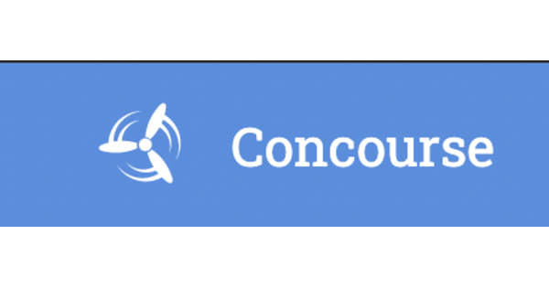







Proposed DevSecOps Architecture- Customer tools
Strategy to Portfolio (S2P)
Develop (Requirement to Deploy)
Work management and collaboration
Coding
Source code management and version control
Planning, Work Management and Development
XRAY
Dev Team
Security
Develop (Requirement to Deploy)
Continuous Integration and Continuous Deployment
Release and Deployment
Testing
Continuous Integration
Gauge
Deliver (Request to Fulfill)
TaaS
Contest
ConnecTat
Operate (Detect to Correct)
Continuous Operations and Continuous Monitoring
Monitoring
Observability
CA-APM
Operations management
Target
Environments

Slide 36
Intelligent Automation Solution for Cariad
Cariad Applications
autoDetect
autoResolve
autoManage
autoImprove
Cariad + DXC
Innovation Council
Operational Insight Dashboard
Data Lake*
ML based Incident Analysis
Monitoring Tool
HP Service Center
CA APM
Digital Command Center
Dynatrace
Cariad/DXC Automation Workbench
Kibana
Resolve Framework
Splunk
MF OO
DXC CASA
CI/CD pipeline
Grafana
Selenium
Jenkins
SonarQube
AMS (Run & Maintain)
DXC included automation accelerators
Cariad Tools
Potential solutions for expanded support

Slide 37







DXC Application Service Automation: Modules
Provides a comprehensive suite of automation capabilities to accelerate, reduce cost and improve the quality of the applications management service
DXC autoDetect
DXC autoResolve
DXC autoImprove
DXC autoManage
Risk reduction of up to 50% by pre-detecting symptoms of potential incidents
Capacity increase of up to 30% through problem resolution, fulfilling service requests
Time to market reduced by up to 40% through continuous delivery change management
Quality improved by up to 60% through process automation and analytics
Real-time monitoring of applications to proactively detect incidents and problems
Automatic resolution of incidents, problems, and service requests without human intervention
Ongoing analysis and continuous improvement of application code and code deployment
Automation of
service management processes and code analytics enables prescriptive applications management
Enabled by
Notes:
Application Service Automation is our end to end Automation capability. In addition to our Bionix optimization and automation assets, we leverage leading edge products and tools from our strategic partners including MicroFocus, Dynatrace, ServiceNow to name a few.
ASA is modular and customized based on client needs to maximize benefits.
There are 4 modules –
autoDetect reduces risk and increases customer satisfaction by real time monitoring and pre-detecting symptoms of potential problems.
autoResolve reduces effort and increases productivity by automatic resolution of incidents and service requests.
autoImprove increases speed to market by continuous Improvement and continuous Delivery
autoManage controls the workflow between other modules, improves overall quality through process automation and analytics
Mainframe: MicroFocus OO to restart batch jobs, identify failed records; alerts.
Monitor interfacing apps; distributed systems,
Hybrid environments => Tools
Pure cloud apps => Native tools
Azure: Azure monitor; apps insights for monitoring; Logic Apps for auto resolve
AWS: Cloudwatch; Lamda functions
GCP: Cloud monitoring; Google Cloud functions

Slide 38
END

Slide 39
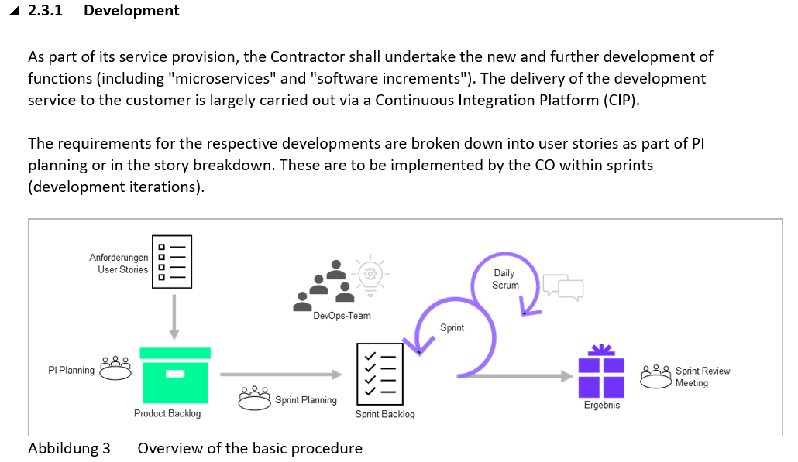

Slide 40
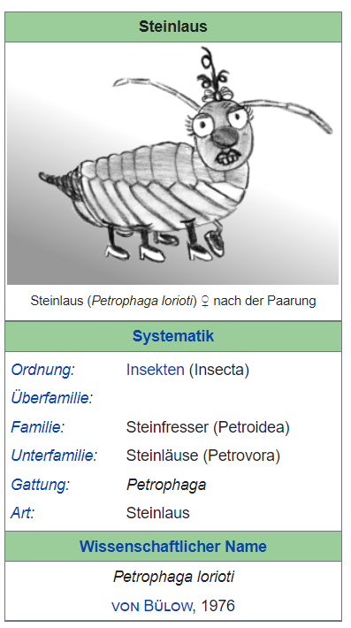
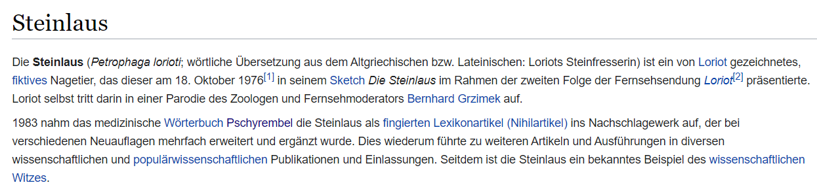
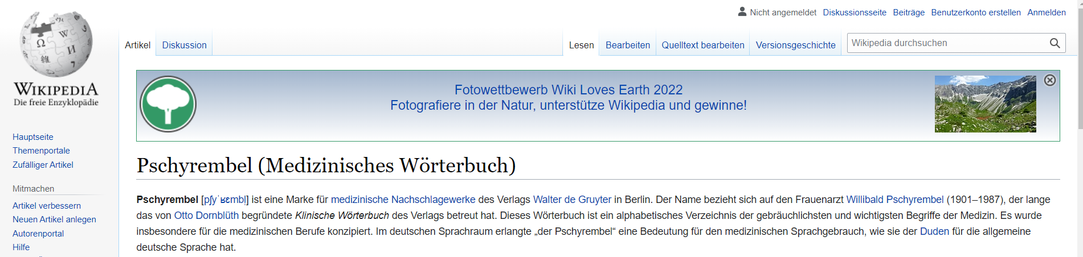
Dear CARIAD colleagues:
1 minute humor "There used to be more tinsel",
... People love humor, we are all just people i.M. Vicco
Liebe CARIAD Kollegen:
1 Minute Humor „Früher war mehr Lametta“,
… Menschen lieben Humor, wir sind alle nur Menschen i.M. Vicco
Only to be used if they ask about
Testframework „Steinlaus“
DXC Tool // The Stone Louse (Petrophaga lorioti; literal translation from ancient Greek or Latin: Loriot's Stone Eater) is a fictional rodent drawn by Loriot, which he wrote on October 18, 1976[1] in his sketch The Stone Louse as part of the second episode of the television show Loriot[2] Presented. Loriot himself appears in a parody of the zoologist and television presenter Bernhard Grzimek.
In 1983, the medical dictionary Pschyrembel included the stone louse as a fictitious lexicon article (Nihilartikel) in the reference work, which was expanded and supplemented several times in various new editions. This in turn led to further articles and explanations in various scientific and popular science publications and statements. Since then, the stone louse has been a well-known example of scientific wit.

